Slide 1

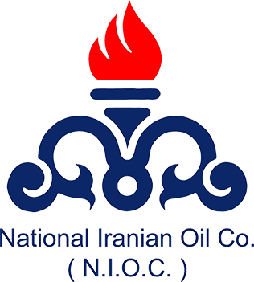
National Iranian Oil Company A Comprehensive Analysis
Ali Hosseinifar
Oct 2023

Slide 2
Table of Contents
Company Profile
1.A brief history of the company
2.Relevant data such as revenues, employees, and market share
3.Governance and ownership structure of the company
Sector Analysis
1.Classification of Economic Activities and leading players in the industry
2.Any barriers to entry and their type
3.Level of concentration within the sector
Strategic Analysis
1.Degree of differentiation of the company
2.Degree of diversification of the company
3.Degree of integration of the company
Sustainability Strategies
Additional Remarks
Conclusion

Slide 3
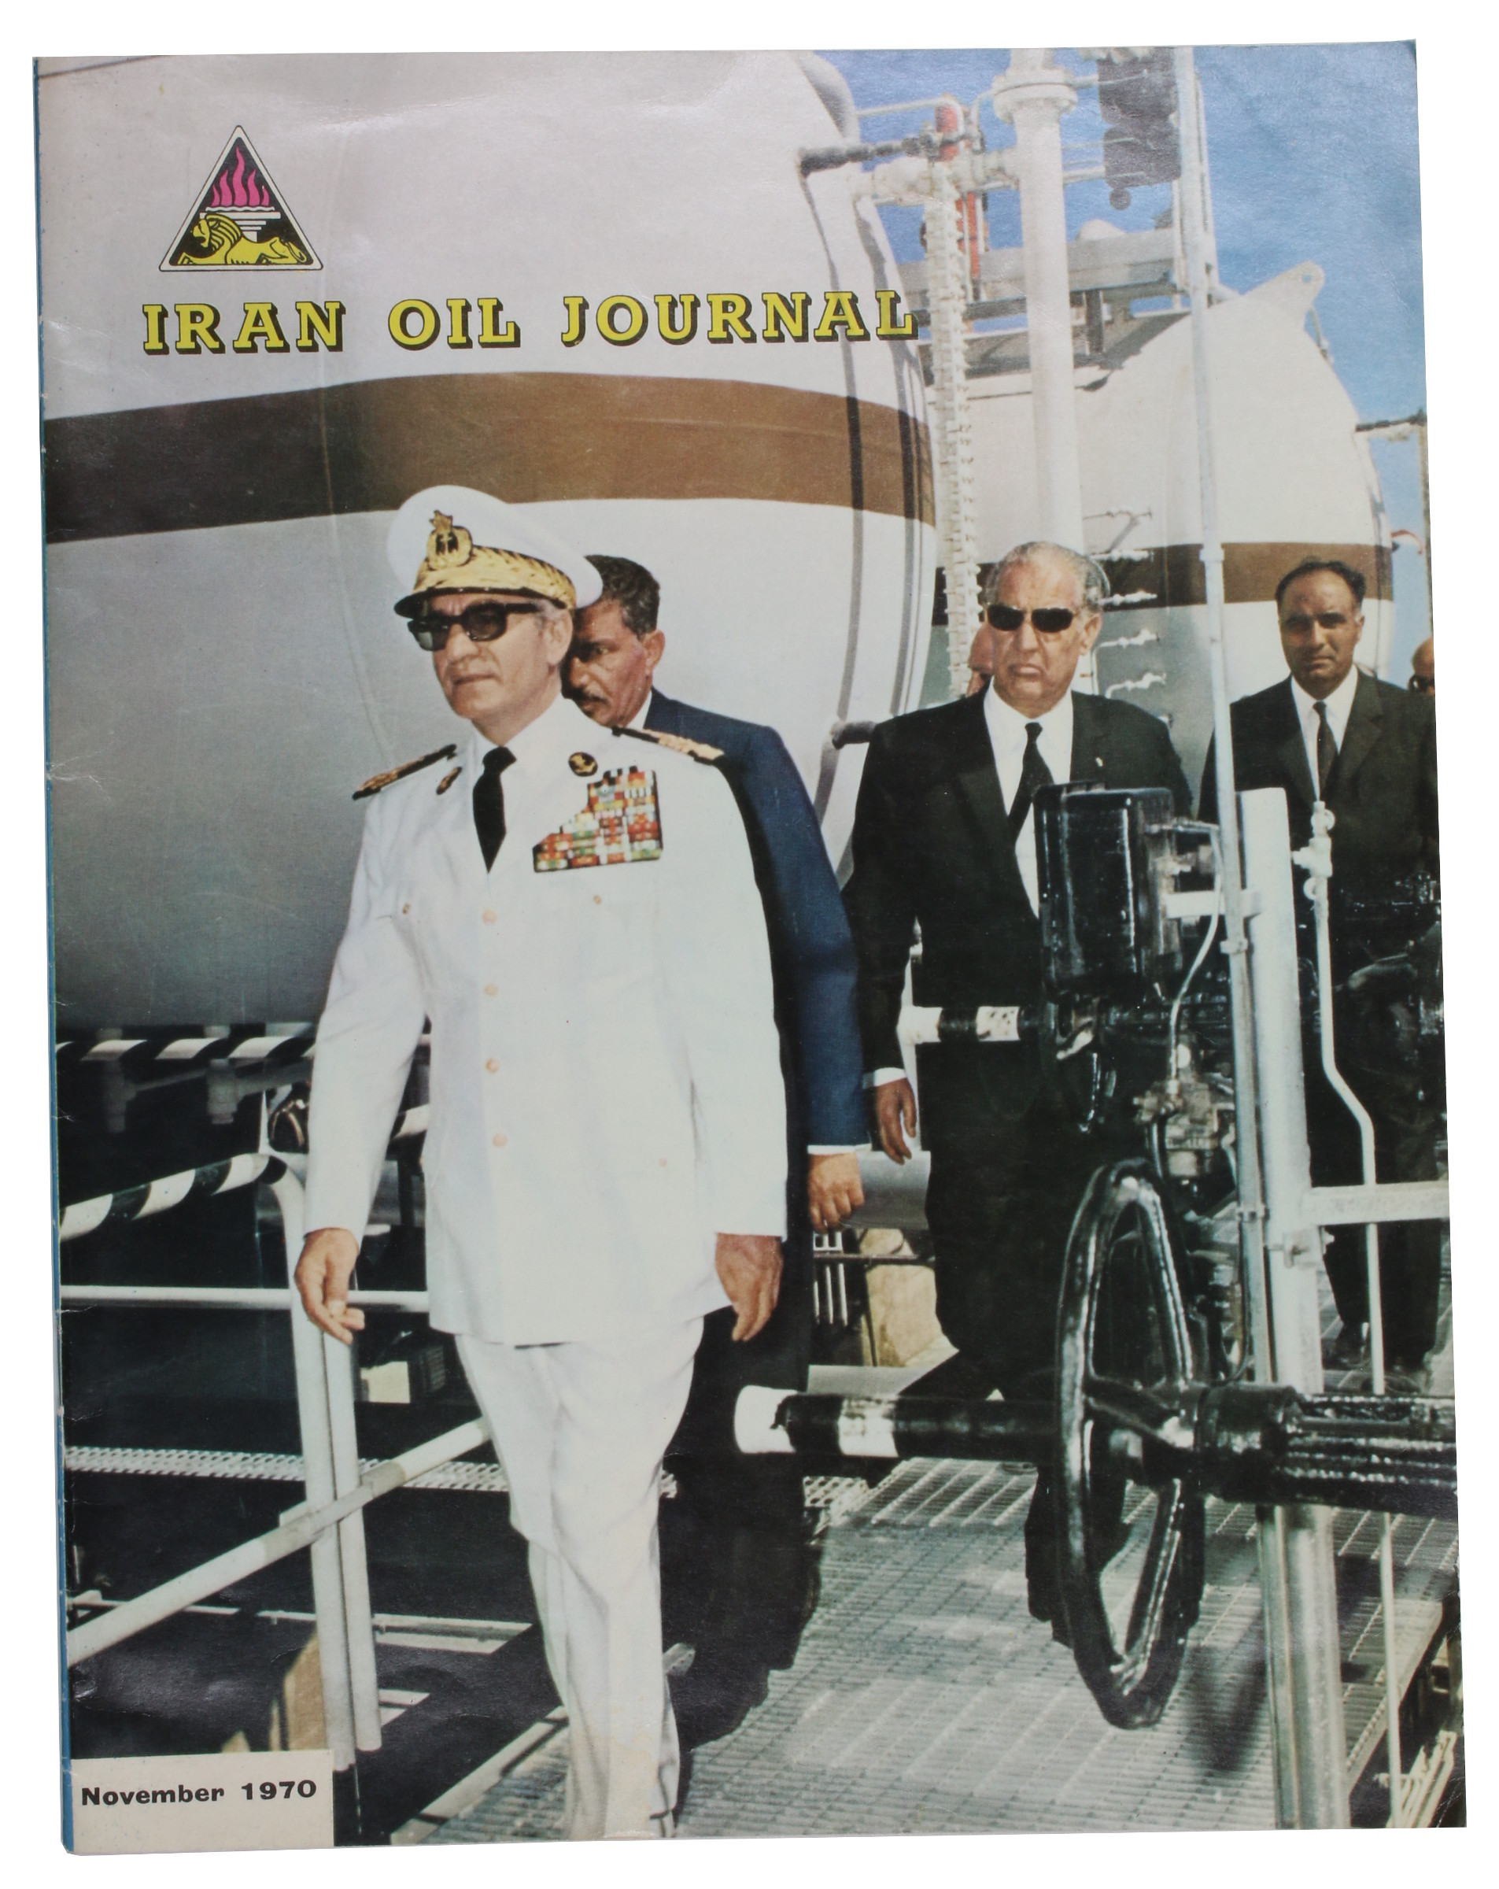
Company Profile: brief history of the company
Established in 1951, the National Iranian Oil Company (NIOC) has a remarkable history. Originating from William Knox D'Arcy visionary efforts in 1901 who was granted a concession by the king of Iran to search for oil, it led to a transformative era. The significant Middle East oil discovery in 1908 marked a turning point. After becoming the Anglo-Iranian Oil Company (AIOC) in 1935, it reverted to NIOC in 1951 post the 1979 Iranian Revolution and asset confiscation (1).This history showcases NIOC's adaptability amid dynamic geopolitical and economic changes.

Slide 4
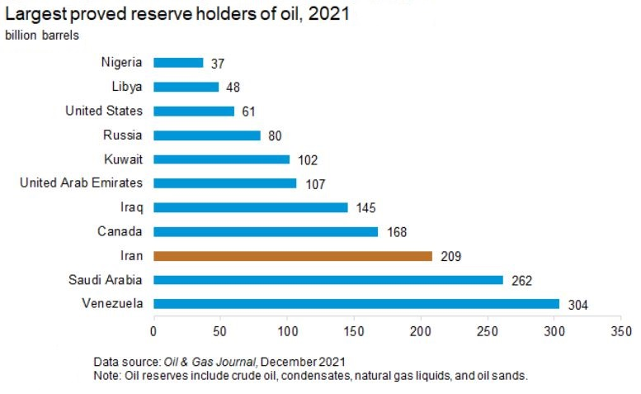
Relevant data such as revenues, employees, and market share
In 2021, Iran held 24% of Middle East oil reserves and 12% globally, solidifying its position as a major player in the global oil market (2) . By 2023, NIOC's revenue had reached a significant milestone of $42.6 billion (3). With a workforce of 87,500 in 2018 (4), NIOC stands as a vital economic force in Iran.
Governance and ownership structure of the company
Ownership: Fully owned by the Iranian government (5).
Supervision: Oversight by the Ministry of Petroleum.
Board of Directors: Appointed by the government to make major decisions.
Subsidiaries: Manages various subsidiaries in oil and gas operations.
International Contracts: Can engage in agreements with international oil companies, subject to government approval.

Slide 5
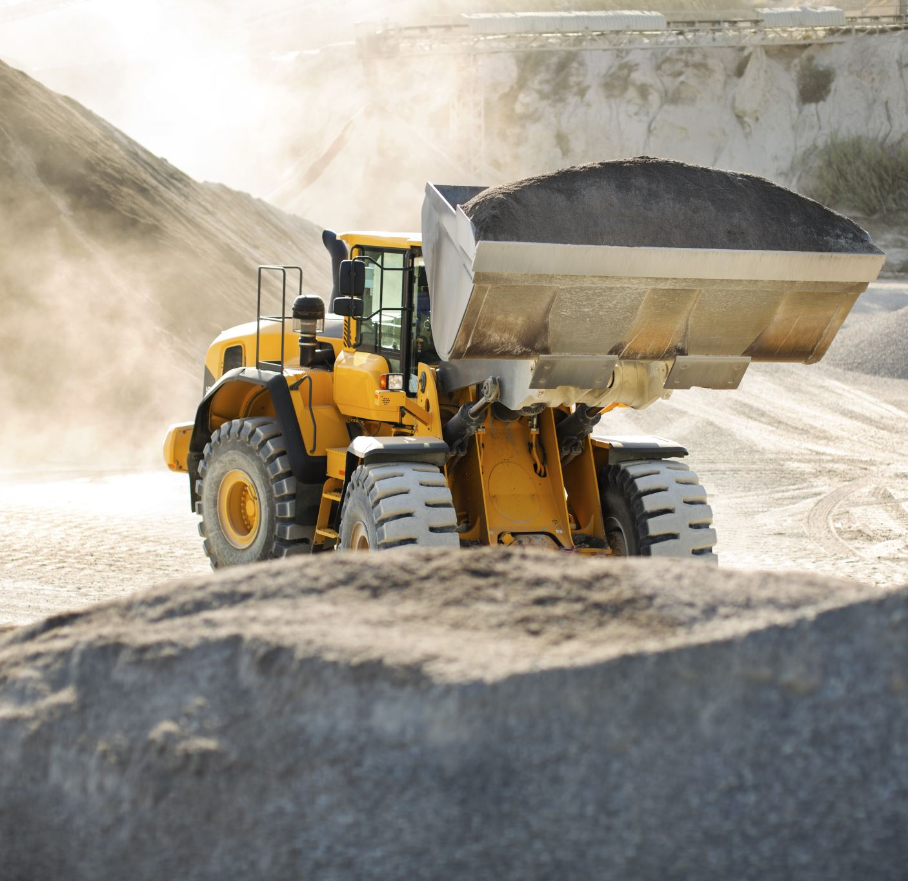

Sector Analysis: Classification of Economic Activities
Within the International Standard Industrial Classification (ISIC) system (6), the National Iranian Oil Company (NIOC) finds its place in the sector of "Mining and Quarrying." NIOC is categorized under:
Section: B - Mining and Quarrying
Division: 06 - Extraction of Crude Petroleum and Natural Gas
Group: 061 - Extraction of Crude Petroleum
Class: 0610 - Extraction of Crude Petroleum
Group: 062 - Extraction of natural gas
Class: 0620 Extraction of natural gas

Slide 6
leading players in the industry
Foreign Companies:
Saudi Arabian Oil Company (Saudi Aramco) - Saudi Arabia
ExxonMobil - United States
Royal Dutch Shell - Netherlands/United Kingdom
BP plc - United Kingdom
Total Energies - France
Chevron Corporation - United States
ConocoPhillips - United States
Eni S.p.A. - Italy
Equinor ASA - Norway
Internal Companies:
National Iranian Gas Company (NIGC) - Iran
National Petrochemical Company (NPC) - Iran
National Iranian Oil Refining and Distribution Company (NIORDC) - Iran
Iranian Offshore Oil Company (IOOC) - Iran
National Iranian South Oil Company (NISOC) - Iran
National Iranian Oil Engineering and Construction Company (NIOEC) - Iran

Slide 7
Any barriers to entry and their type
High Capital Requirements: The industry demands significant financial resources for exploration, drilling, refining, and distribution. NIOC's government backing provides a competitive edge.
Technological Expertise: Advanced technology is vital for efficient operations, presenting a barrier for new entrants.
Regulatory Hurdles: The industry faces complex domestic and international regulations. NIOC's established regulatory framework and government relationships provide an advantage.
Access to Reserves: Established firms like NIOC have secured long-term contracts, making it challenging for newcomers to access reserves.
Economies of Scale: Large companies like NIOC benefit from spreading costs over higher production volumes, a challenge for new entrants.
Long Project Development: Oil and gas projects have extended development timelines, requiring secure financing, a challenge for new entrants.
Market Access and Channels: Established firms possess well-developed distribution networks and international access, which new entrants must establish.

Slide 8
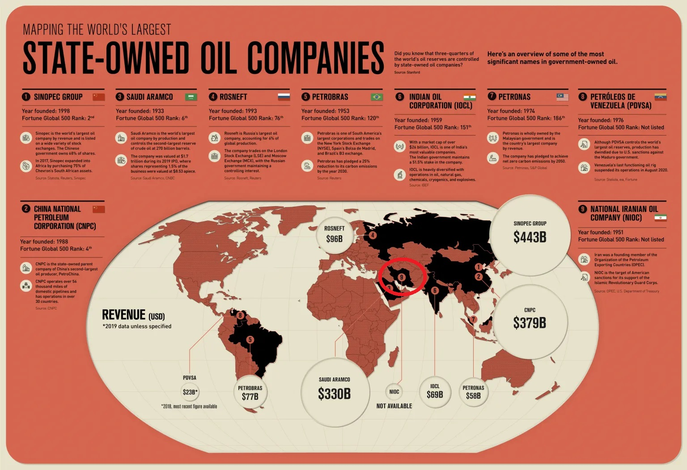
Level of concentration within the sector
National Iranian Oil and Gas Company (NIOC) operates within the Iranian oil and gas sector, which is characterized by a high level of concentration. This is primarily due to the dominant role of NIOC as the state-owned (7) entity responsible for the exploration, production, and management of Iran's oil and gas reserves. NIOC holds a significant monopoly over Iran's oil and gas resources, and it is the primary player in the Iranian oil and gas sector.

Slide 9
Strategic Analysis: Degree of differentiation of the company
The National Iranian Oil and Gas Company (NIOC) operates in a highly specialized and vertically integrated industry. It covers various aspects of the oil and gas sector, including exploration, production, refining, and distribution (10). This makes NIOC a vertically integrated company with a high degree of differentiation, as it manages the entire value chain within the Iranian oil and gas sector.
This means how much NIOC stands out or is different from other companies in the same industry. Because NIOC handles all aspects of the oil and gas process within Iran, from finding it underground to delivering it as a usable product, it's considered highly differentiated.

Slide 10
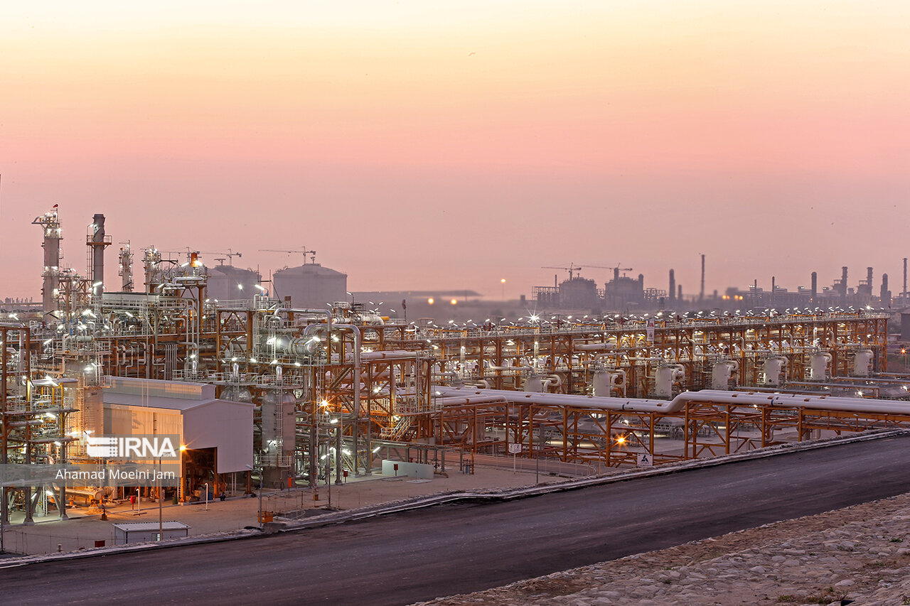
Degree of Diversification of the Company
NIOC employs a moderate diversification strategy within the energy sector. This involves activities related to oil and gas, including exploration, production, refining, and petrochemicals.
This means the company engages in multiple related activities within the energy sector. This strategy helps spread risk and navigate challenges associated with the industry.

Slide 11
Advantages:
The company can leverage synergies between its different businesses, potentially leading to cost savings, shared resources, and enhanced competitiveness.
Risk is spread across related industries, reducing dependency on a single market.
Disadvantages:
Managing diverse businesses requires a higher level of expertise and potentially more complex organizational structures.
The company may still face risks if the related industries face common challenges or downturns.

Slide 12
Product/Service Portfolio: NIOC primarily focuses on oil and gas exploration, production, and related activities. It also engages in refining and petrochemicals.
Market Segments: NIOC's operations are primarily focused on the energy sector, with activities spanning exploration, production, refining, and distribution.
Geographical Presence: NIOC's operations are primarily centered in Iran, with some international activities, particularly in neighboring countries.
Revenue Sources: The majority of NIOC's revenue is derived from oil and gas-related activities, with a smaller portion from refining and petrochemicals (11).
Risk Mitigation: Diversification within the energy sector can help NIOC mitigate risks associated with fluctuations in oil prices and geopolitical tensions.

Slide 13
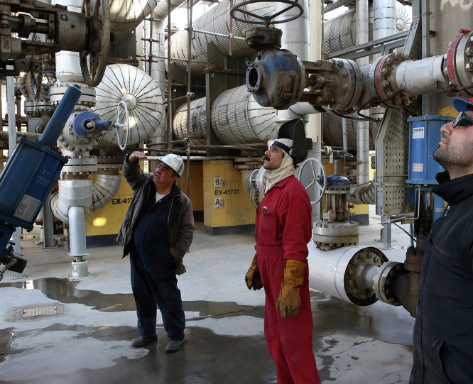
Degree of Integration of the Company
Vertical Integration involves a company's control over different stages of the production or supply chain. NIOC, this translates to a substantial level of vertical integration, spanning upstream (exploration and production), midstream (transportation and storage), and downstream (refining and distribution) activities.
Horizontal Integration is about expanding within the same stage of the production or supply chain. While NIOC primarily functions as a state-owned entity, it may establish collaborations and partnerships with international companies for specific projects, indicating a potential form of horizontal integration.

Slide 14

Sustainability Strategies
The National Iranian Oil Company (NIOC) lacks a clear sustainability strategy and shows minimal engagement in the low-carbon transition. It lacks net-zero targets, transition plans, and climate strategies. Limited data disclosure and absence of climate governance and incentives for low-carbon practices are observed (12).
NIOC's focus on increasing oil and gas production post-sanctions implies a continued reliance on fossil fuels without a transition plan to a low-carbon economy. This contradicts global efforts to combat climate change.

Slide 15
Sustainability Strategies
Diversification of Revenue Streams:
Invest in R&D for renewable energies.
Explore solar, wind, and hydroelectric power.
Carbon-Neutral Technologies:
Allocate resources for carbon capture and storage (CCS) and low-emission extraction.
Environmental Impact Mitigation:
Conduct thorough assessments.
Minimize habitat disruption and protect biodiversity.
Regulatory Compliance:
Adhere to evolving environmental standards.
Uphold industry best practices.
Transparency and Reporting:
Demonstrate ESG(*) performance.
Build stakeholder trust.
Community Engagement:
Address stakeholder concerns.
Invest in education, healthcare, and infrastructure.

Slide 16
Additional Remarks
The story of the National Iranian Oil Company (NIOC) is not just about economics. It involves how the money from oil impacts the lives of everyday Iranians. Unfortunately, there have been concerns about how this money is managed. Some believe it's not always used in the best way for the people. This has led to questions about fairness and transparency.
Additionally, there have been times when oil money is used for political purposes. This sometimes means that political goals take precedence over the needs of the citizens. This isn't just about NIOC, but a larger issue with how the government handles its resources. To make a real change, there needs to be improvements in how the country is governed.
The recent designation by the U.S. Department of the Treasury underscores the complex ties between Iran's oil industry and geopolitical interests. The Iranian Ministry of Petroleum, NIOC has been designated for its alleged support to IRGC-QF, highlighting questions about revenue transparency. This development also reveals the intricate relationships between Iran's oil sector and its broader political agenda, necessitating a delicate balance in international relations (13).

Slide 17
Conclusion
The National Iranian Oil Company (NIOC) is a pivotal player in the global oil and gas industry, rooted in a resilient history since 1951. NIOC's substantial market shares and government ownership solidify its position. While barriers to entry exist, its established regulatory framework and advanced technology provide a competitive edge.
NIOC's strategic integration across the value chain highlight its forward-thinking approach. However, questions surrounding revenue management and recent geopolitical designations necessitate careful governance.
In this evolving landscape, NIOC's role is critical in steering Iran towards a sustainable energy future, contributing to a greener global energy landscape. This signifies a significant step forward for Iran and the international community.

Slide 18
References
(1) https://en.wikipedia.org/wiki/National_Iranian_Oil_Company
(2) Oil & Gas Journal, Worldwide look at reserves and production (December 2021).
(3) Greenway, Robert. "Trump's Iran Advisor: Biden's 'Flying Dutchman' Foreign Policy Brought Us Chaos." Director, Center for National Defense, The Heritage Foundation; Former Deputy Assistant to the President & Senior Director, National Security Council Middle East and North Africa. RedState. https://redstate.com.
(4) https://en.wikipedia.org/wiki/National_Iranian_Oil_Company
(5) National Iranian Oil Company (NIOC) from worldbenchmarkingalliance
(6) International Standard Industrial Classification of All Economic Activities, Revision 4
(7) National Iranian Oil Company (NIOC) from worldbenchmarkingalliance
(8) “NIDC DRILLING 158 OIL, GAS WELLS IN 20 MONTHS" ( https://www.ice.it/it/news/notizie-dal-mondo/242421)
(9) Country Analysis Executive Summary: Iran from U.S. Energy Information Administration (eia) https://www.eia.gov/
(10) https://en.wikipedia.org/wiki/National_Iranian_Oil_Company
(11) IRAN’S ENERGY POLICY AFTER THE NUCLEAR DEAL, Sara Vakhshouri, 2015
(12) National Iranian Oil Company (NIOC) from worldbenchmarkingalliance
(13) U.S. Department of the Treasury. "Treasury Sanctions Key Actors in Iran’s Oil Sector for Supporting Islamic Revolutionary Guard Corps-Qods Force." https://home.treasury.gov/news/press-releases/sm1165

